Slide 1
How the Internet Works
(in 1 hour)

Slide 2
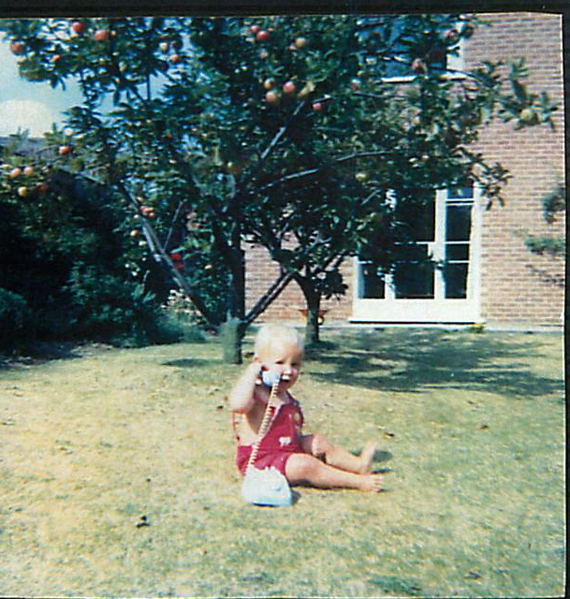
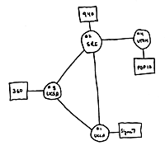
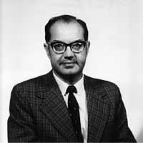
Four nodes connected (UCLA, SRI, UCSB, Utah)
Professor Nick McKeown 1964
“A network to survive nuclear attack.”
US Government starts “ARPANET” project
1st network connects two computers
Paul Baran
1964
1965
1966
1968
1969

Slide 3
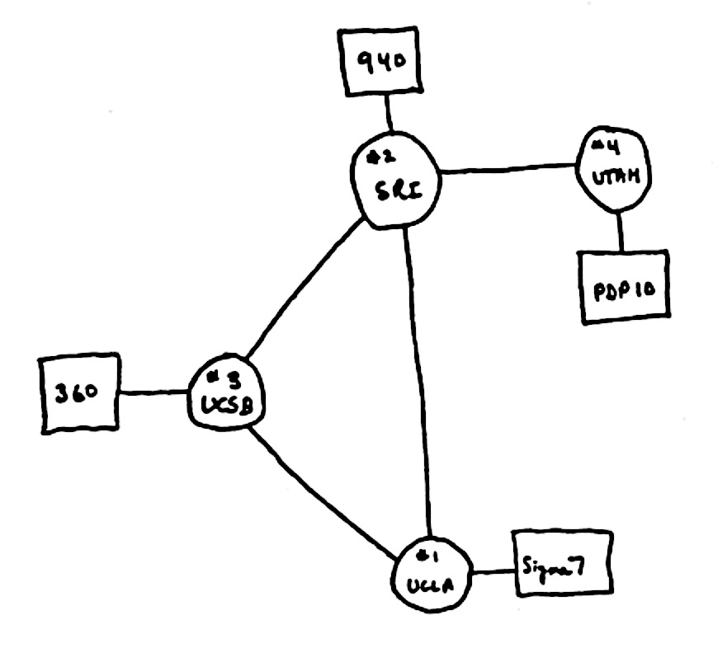
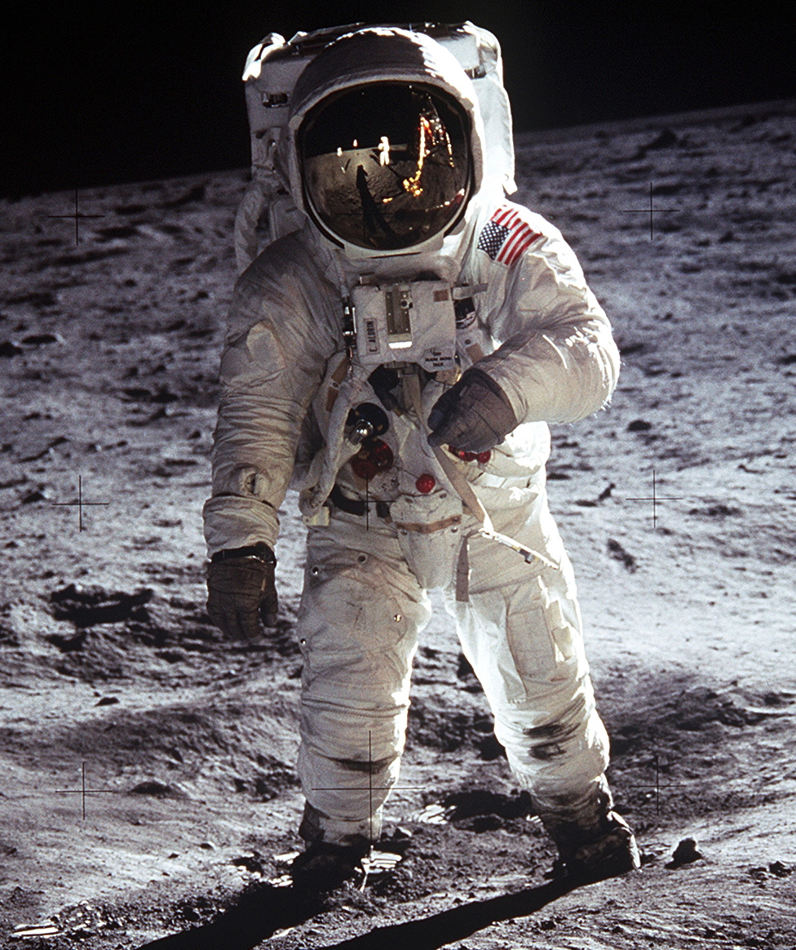
The Internet in 1969
“router”
“end host”
Also in 1969
“link”

Slide 4
What did they use it for?
“router”
“end host”
“link”
Sending files between scientists: “Here is a big file of astronomy data!”
Email: “Where shall we have lunch today?”
Remote login to another computer.

Slide 5
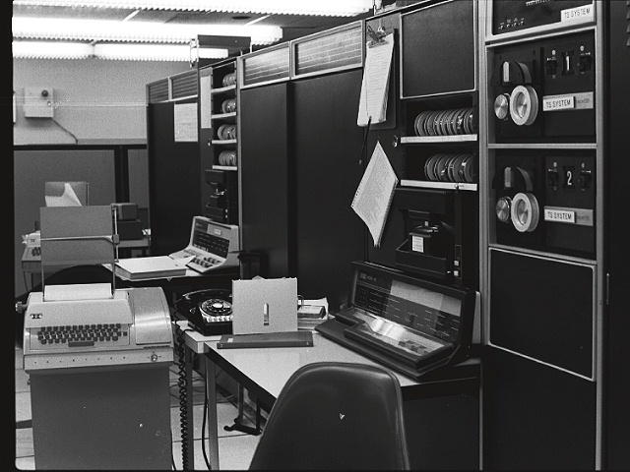
1971
First email typed here
“QWERTYUIOP”
…and printed here

Slide 6
“router”
1993
1,000,000 “end hosts”
“end host”
“link”
1988
10,000 “end hosts”
1969
4 “end hosts”

Slide 7
Then in 1993 something REALLY BIG happened!!!

Slide 8
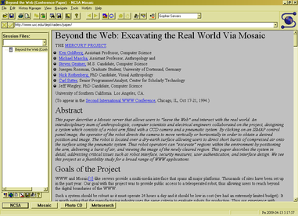

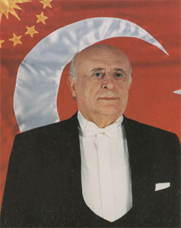
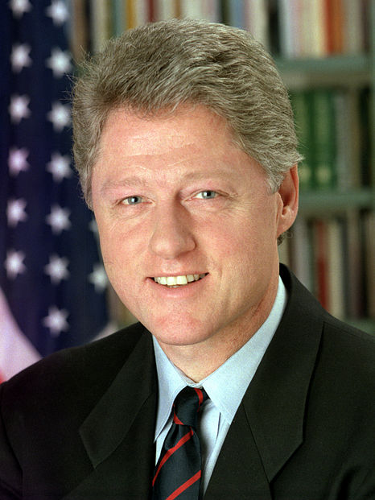
1993: The first web browser (Mosaic)
Marc Andreessen
1993
President
Süleyman Demirel
President
Bill Clinton

Slide 9
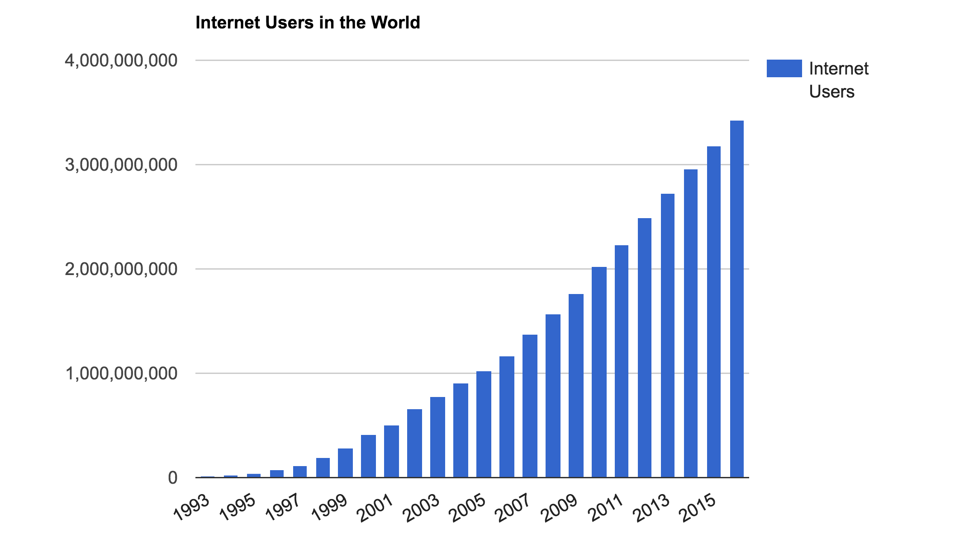
The number of Internet users in the world
3.6B people
~ 40% of world
Source: http://www.internetlivestats.com/
Notes:
Internet user = someone who has access to the Internet from home (by any device)
7.4B in the world, so still less than 50% of people.

Slide 10
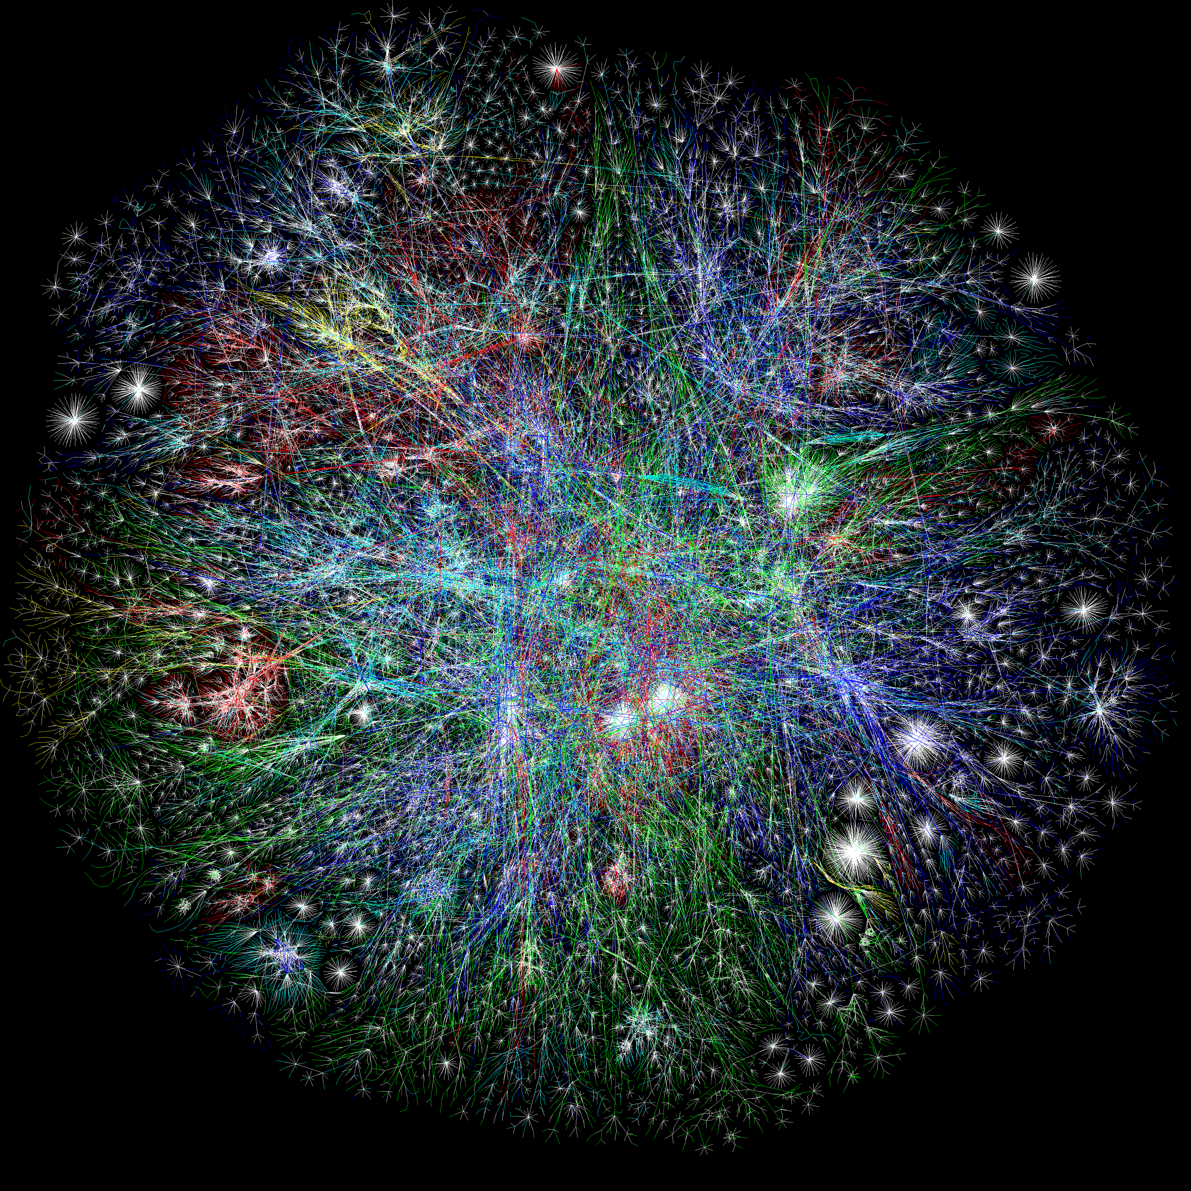

Slide 11
How does it all work?

Slide 12



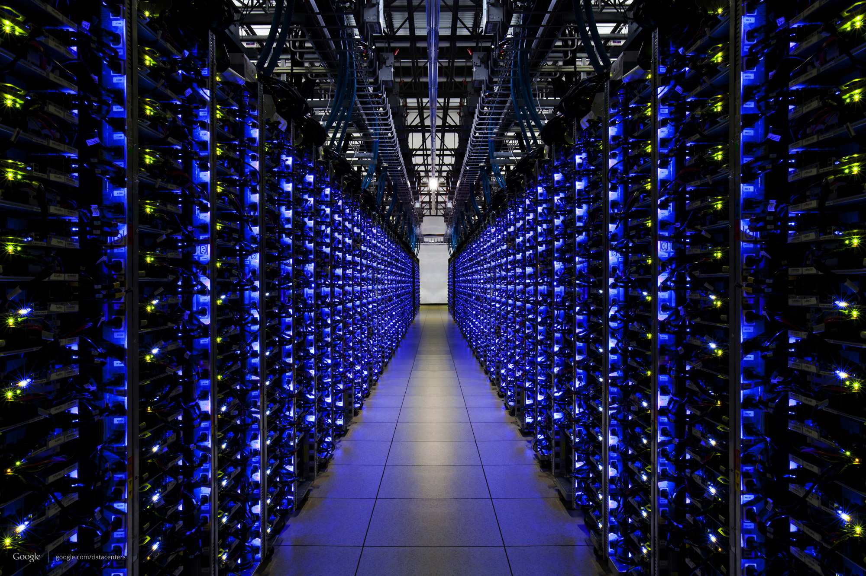
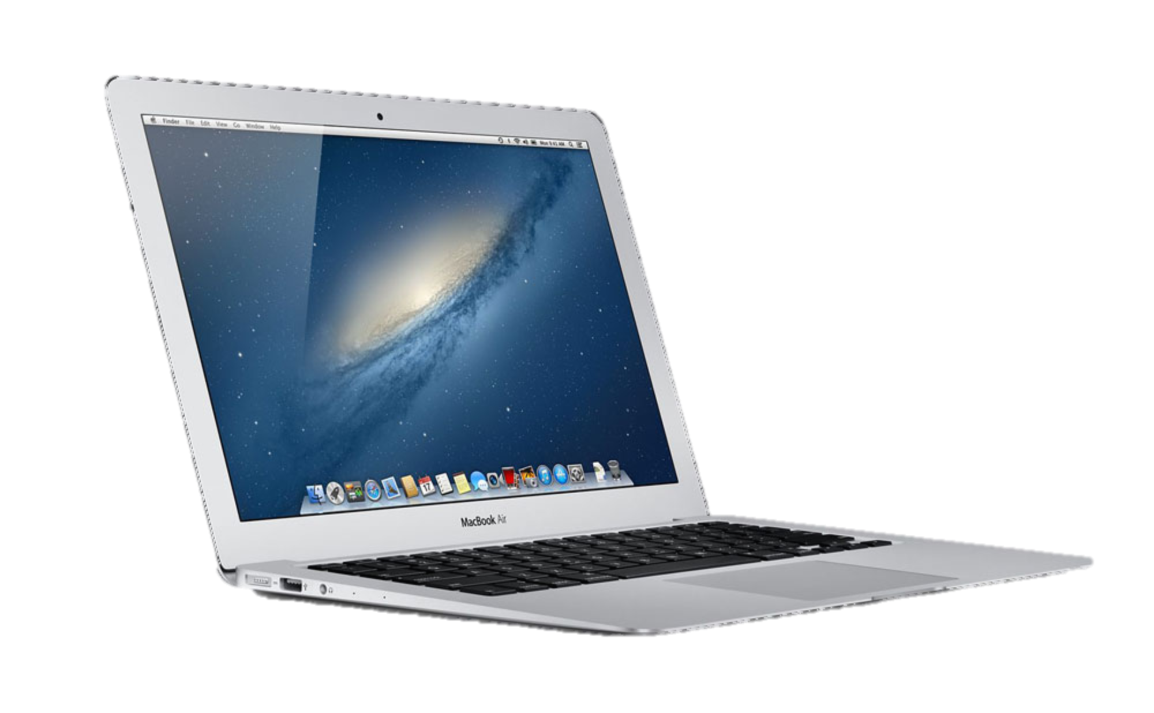

Slide 13
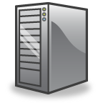
Someone else’s
Java Program
My Java
Program

Slide 14
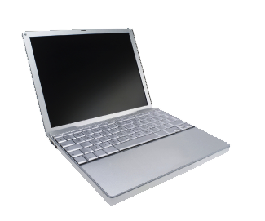
Data
Data

Slide 15
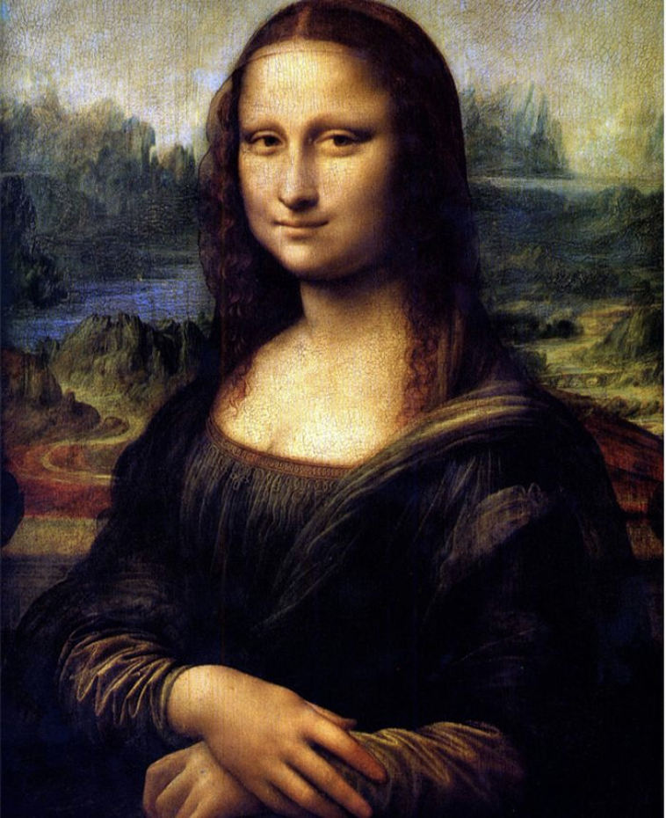
Notes:
Let’s see how this image is sent across the Internet from one smartphone to another….

Slide 16
Notes:
Let’s see how this image is sent across the Internet from one smartphone to another….

Slide 17
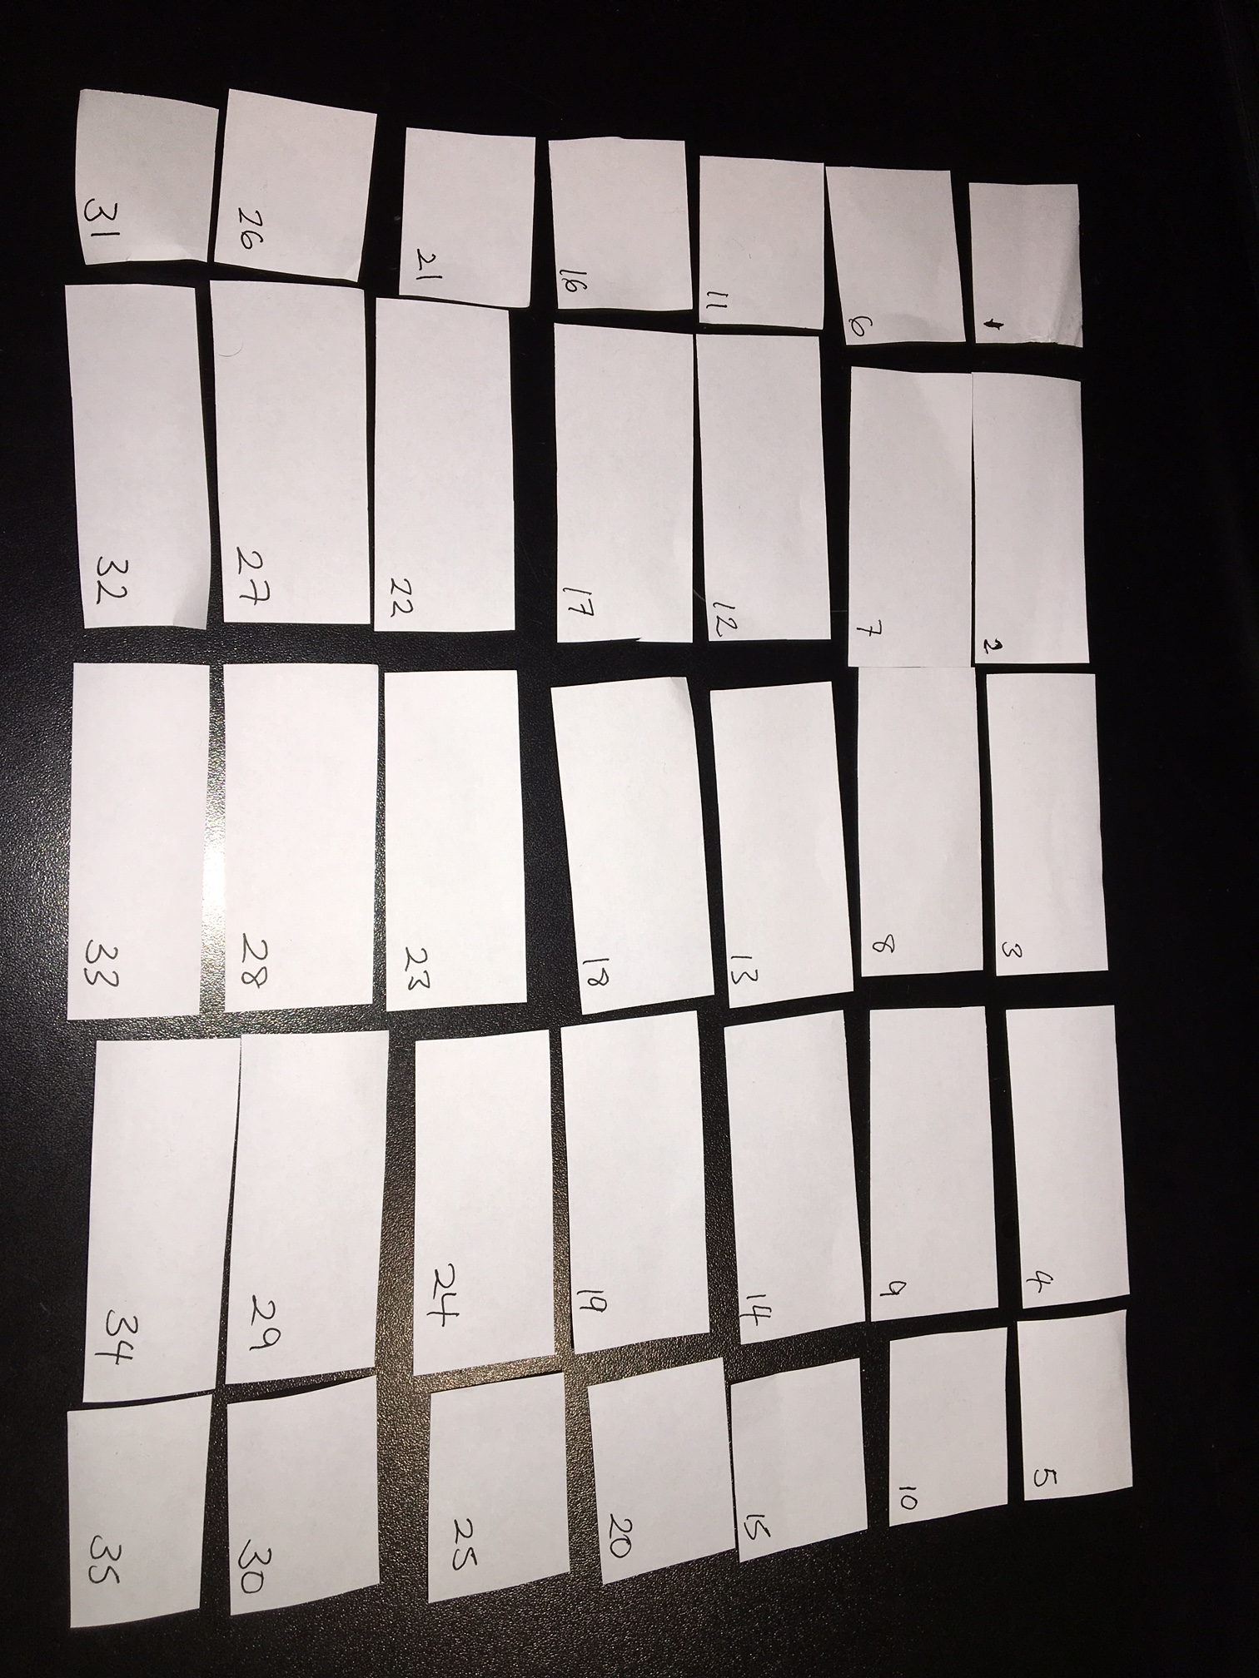

Slide 18
Packets may be damaged
?!%%*
Data
Data

Slide 19
Packets may arrive out of order
1
2

Slide 20
Packets may be duplicated
Duplicate
Data
Data

Slide 21
They may not arrive at all!
Data
Data
Full

Slide 22
Summary so far
Applications send and receive data in packets….
…over an Internet that is unreliable.

Slide 23
What do Internet packets look like?

Slide 24
Internet addresses
Data
Internet “IP”
Address
Data

Slide 25
Internet Addresses (“IP address”)
Data
Internet “IP”
Address
All Internet packets carry a destination IP address.
We usually write the IP address like this:
171.64.74.58

Slide 26
Internet “IP” Addresses
The IP address tells each router where to send the packet next.
Stanford University
A network in the CS department at Stanford University
171.64.74.58
The computer yuba.stanford.edu

Slide 27
Can we see the path our packets take?
Yes!
On your computer, try: “ping yuba.stanford.edu”
and “traceroute yuba.stanford.edu”
(Windows: “tracert yuba.stanford.edu”)
Notes:
traceroute –q1 yuba.stanford.edu

Slide 28
ping yuba.stanford.edu
From Turkey, it takes about 180ms to reach yuba and back again (“round-trip-time”)

Slide 29
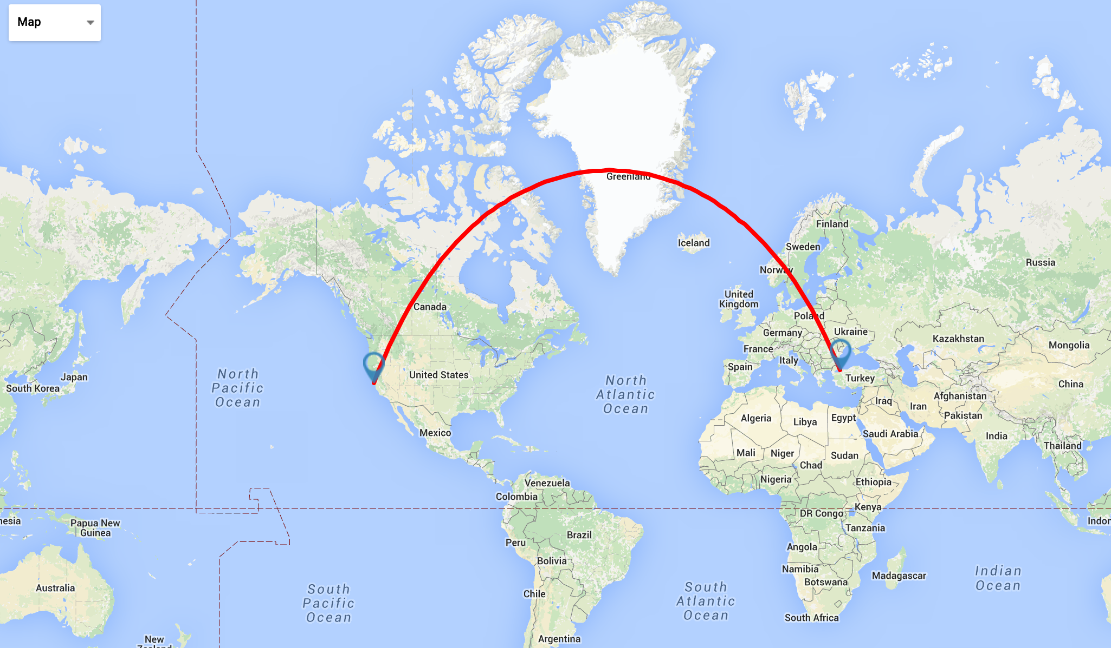
About 180ms “round-trip”

Slide 30
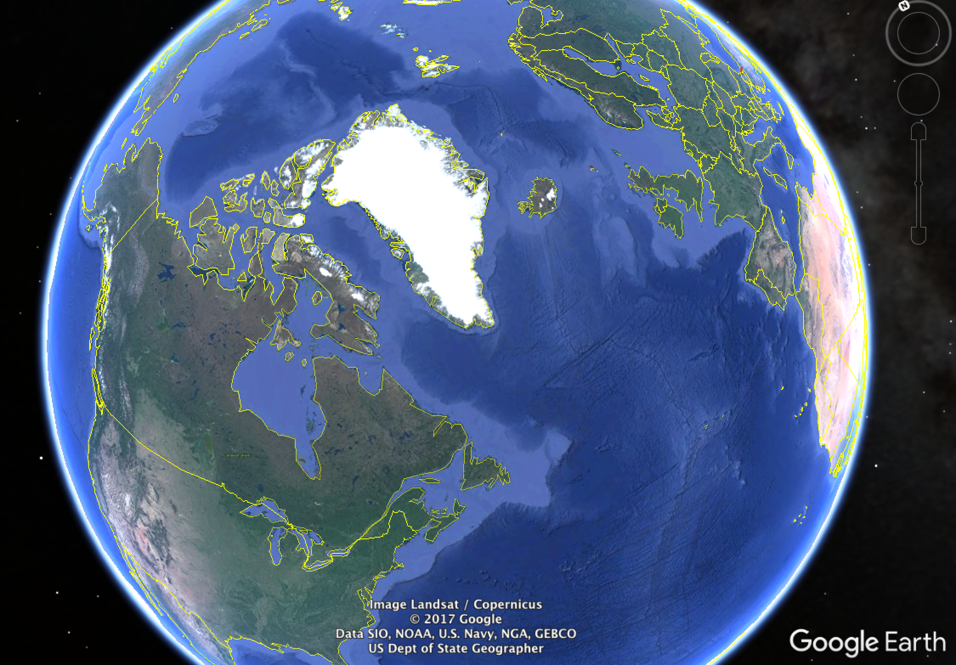
Koc University
Istanbul
Stanford University
California, US
Notes:
ping www.cambridge.ac.uk
Traceroute –q1 www.cambridge.ac.uk

Slide 31

Koc University
Istanbul
10,000km
(50ms)
Stanford University
California, US
Notes:
ping www.cambridge.ac.uk
Traceroute –q1 www.cambridge.ac.uk

Slide 32

Koc University
Istanbul
18,000km
(90ms)
Stanford University
California, US
The real path
our packets take
2 x 90ms = 180ms
Notes:
ping www.cambridge.ac.uk
Traceroute –q1 www.cambridge.ac.uk

Slide 33
How packets find their way across the Internet

Slide 34
Routers forward packets one at a time.
Routers look at IP addresses, then send packets to a router closer to the destination.
Data
Data

Slide 35
IP Addresses
The IP address tells a router where to send the packet next.
IP addresses have structure (yapı)
The computer yuba.stanford.edu
Stanford University
A network in the CS department at Stanford University
171.64.74.58
An address at Koç University
The computer www.ku.edu.tr
An address managed by RIPE (European IP Networks)
88.255.96.208

Slide 36
Summary so far
Applications send and receive data in packets….
…over an Internet that is unreliable.
Packets are forwarded hop-by-hop based on the final destination address.

Slide 37
Sending data reliably over an Internet that is unreliable

Slide 38
Your Application program
e.g. Chrome, Skype
The server
e.g. Google, Facebook
TCP makes sure all
the data is delivered
“TCP”
“TCP”
“IP”
“IP”
Data

Slide 39
TCP’s job
Makes sure all data is delivered correctly.
Delivers data to the application in the right order.
How?
Add sequence numbers to every packet (so the receiver can check if any are missing, and put them in right order)
When a packet arrives, send an acknowledgment of receipt (alındığı onay) or “ACK” back to the sender
If no acknowledgment is received, resend the data

Slide 41
http client (e.g. Chrome)
Chrome
http request
Application
GET index.html
TCP
TCP
TCP
“Deliver to the http server”
(http)
(http)
IP
IP
TCP
IP address
(TCP)
IP
IP address
(TCP)
“…at this destination”
(http)
Ethernet
Ethernet
IP
Ethernet
Ethernet “MAC” address
(IP)
“…starting with this link”
TCP
Ethernet “MAC” address
(IP)
IP address
(TCP)
(http)

Slide 42
Here it goes….
Ethernet data
IP data
TCP data
IP Address
(TCP)
Ethernet “MAC” address
(IP)
(http)

Slide 43
http server (e.g. www.google.com)
http server
http request
Application
GET file
“Deliver to the http server”
TCP
TCP
(http)
“Deliver to TCP”
IP
Ethernet
IP
IP
Ethernet
TCP
TCP
Ethernet “MAC” address
(IP)
IP address (TCP)
IP address
(TCP)
(http)
(http)

Slide 44
Summary of what we learned
My Java
Program
Someone else’s
Java Program
Applications send and receive data in packets….
…over an Internet that is unreliable.
Packets are forwarded hop-by-hop using the IP destination address.
Our applications use TCP to make sure they are
delivered and put back in the correct order.

